Slide 1
Objective Functions of NONMEM®: FOCE, LAPL
Kyun-Seop Bae MD PhD
Department of Clinical Pharmacology and Therapeutics
University of Ulsan

Slide 2
FOCE without INTER
or
E(Y) ≈ F₁ - G₁*EBE
V(Y) ≈ G₁ΩG₁^{T} + diag(H₀ΣH₀^{T})
Y ~ N(E(Y), V(Y))
-> Use MLE

Slide 3
FOCE with INTER (FOCEI)
Eta-Epsilon interaction consideration means we need second order approximation of objective function (not F) with respect to (w.r.t.) parameters (θ, Ω, Σ).
Objective function for FOCEI is basically same with that of LAPLACIAN except that FOCEI uses first derivative of F w.r.t. eta instead of second derivative of F w.r.t. eta.
Objective function for FOCEI will be explained fully after explanation of LAPL method.

Slide 4
INTER option
In case of additive error model for epsilon (Y = F + ε): with or without INTER option, the result is same.
Other than additive error model for epsilon: Using INTER option is statistically correct.
NONMEM prints H1 in table not H0 (for FOCE with other than additive error model even) without INTER option. But only H0 is used for the OFV.

Slide 5
FOCE without INTER
All of the above is calculated with eta_true = EBE.

Slide 6
POSTHOC option with FOCE or LAPL
POSTHOC option is not necessary with FOCE or LAPL, because EBE (post-hoc eta) is calculated at each iteration.
One iteration of FOCE or LAPL is same with complete estimation of FO with POSTHOC option.

Slide 7
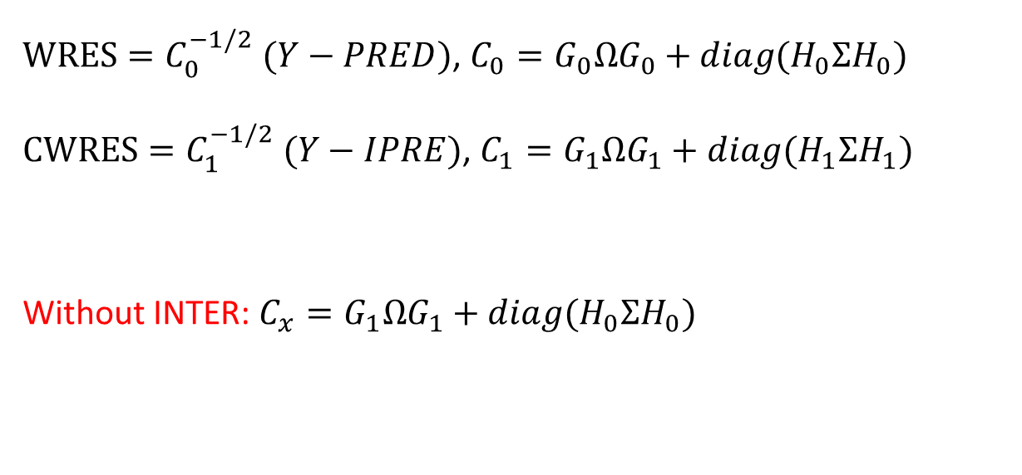
WRES vs CWRES CWRES: Conditional WRES
$WRES=C_{0}^{−1/2} (Y−PRED)$, $C_{0}=G_{0}ΩG_{0}+diag(H_{0}ΣH_{0})$
$CWRES=C_{1}^{−1/2} (Y−IPRE)$, $C_{1}=G_{1}ΩG_{1}+diag(H_{1}ΣH_{1})$
Without INTER: $C_{x}=G_{1}ΩG_{1}+diag(H_{0}ΣH_{0})$

Slide 8
Take home message
Currently, the main estimation is not FO nor Laplacian, but FOCE with INTER.
If you use other than additive residual error model, include INTER option always.
CWRES is much more important than WRES or IWRES, because NONMEM® OFV is optimized using this or similar one.

Slide 9
NONMEM® Objective Function: Laplacian
NONMEM Users Guide VII, p5
See Yaning’s article (2007) for the derivation of the above equation
Last term is approximated as zero.
Could you express Oi not with Φ, Γ, Δ but with Y, F, G, H to calculate OFV?

Slide 10
Likelihood from i-th individual and j-th observation

Slide 11
Γ_{i} in terms of Y, F, G

Slide 12
Δ_{i} in terms of Y, F, G
For LAPLACIAN
For FOCE with INTER

Slide 13
Laplacian Objective Function (Users Guide VII, p5)
V=diag(HΣH^{T})
F=IPRE

Slide 14
G matrix in NONMEM®
D

Slide 15
H matrix in NONMEM®

Slide 16
FOCE with INTER
V=diag(HΣH^{T})
F=IPRE
Cf) Objective Function for EBE

Slide 17
Demonstration using R Package nmw
>install.packages(“nmw”)
>library(nmw)
># Run scripts of the package manual for Theoph dataset.

